Slide 1


4216 UK Weather Data Analysis
Tuesday 5th April 2022
XXX
Cameron Marsh, Ethan Ibrahim,
Laura J. Phillips, Luke Citrine
Luke Curren, Niamh Walsh, Shane Mendis
Cameron Marsh, Ethan Ibrahim,
Laura J. Phillips, Luke Citrine
Luke Curran, Niamh Walsh, Shane Mendis

Slide 2
















Luke Curran
1/4
Assignment Approach
Resources
Closure & Review
Enablers /
Risks & Issues
Functionality & Scope
Plans & Comms
(UK Data covers England and Wales, only.)

Slide 3
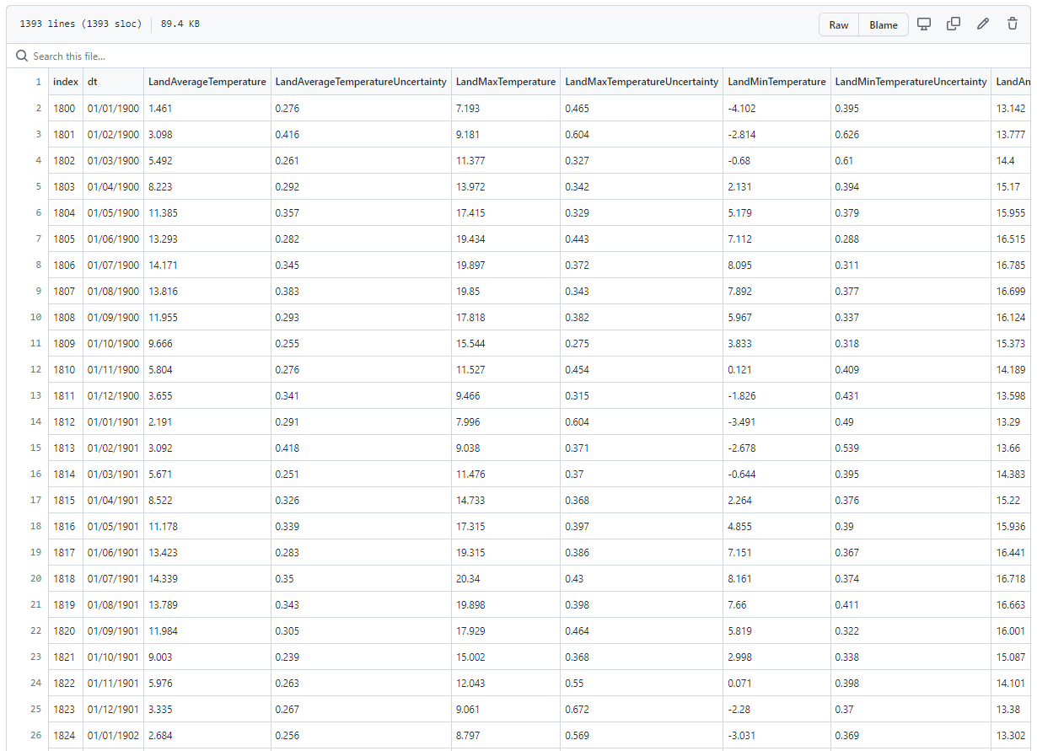
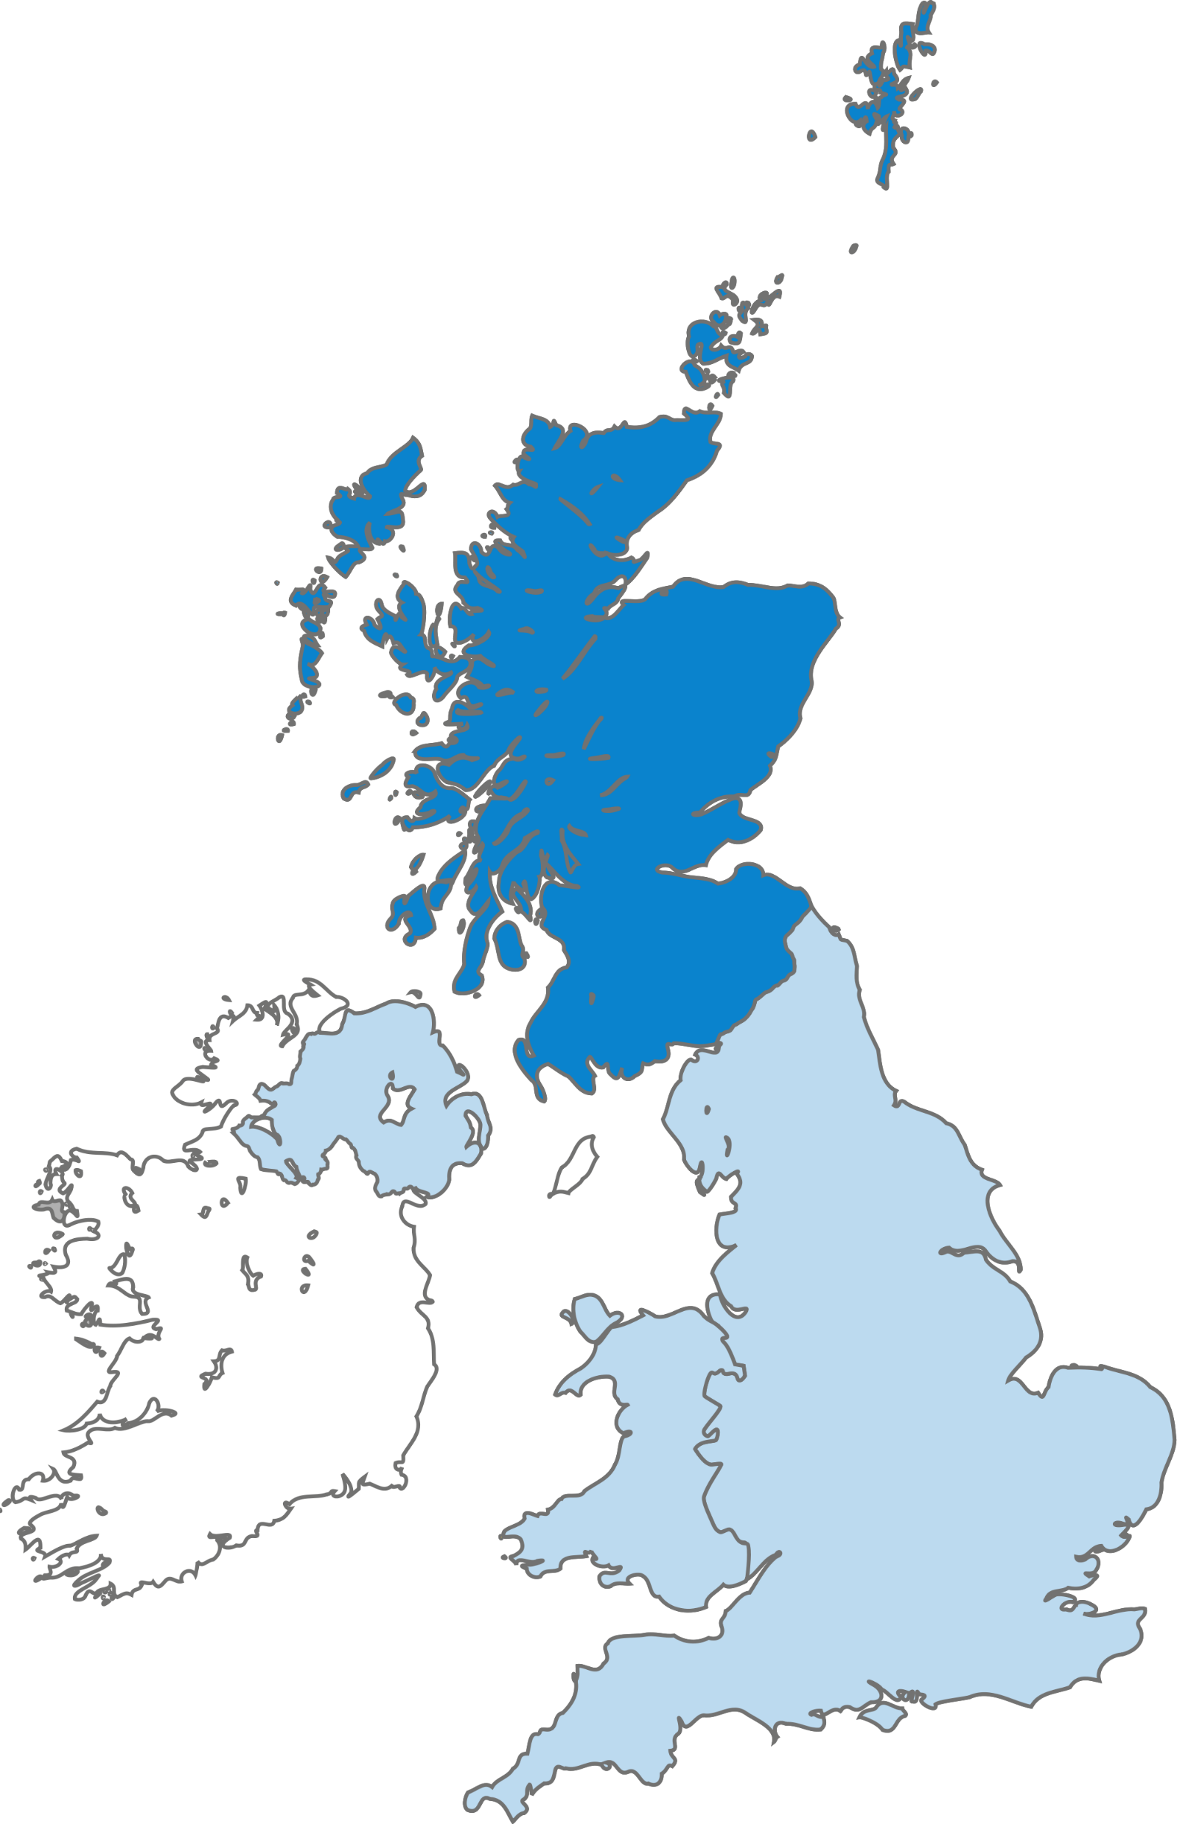

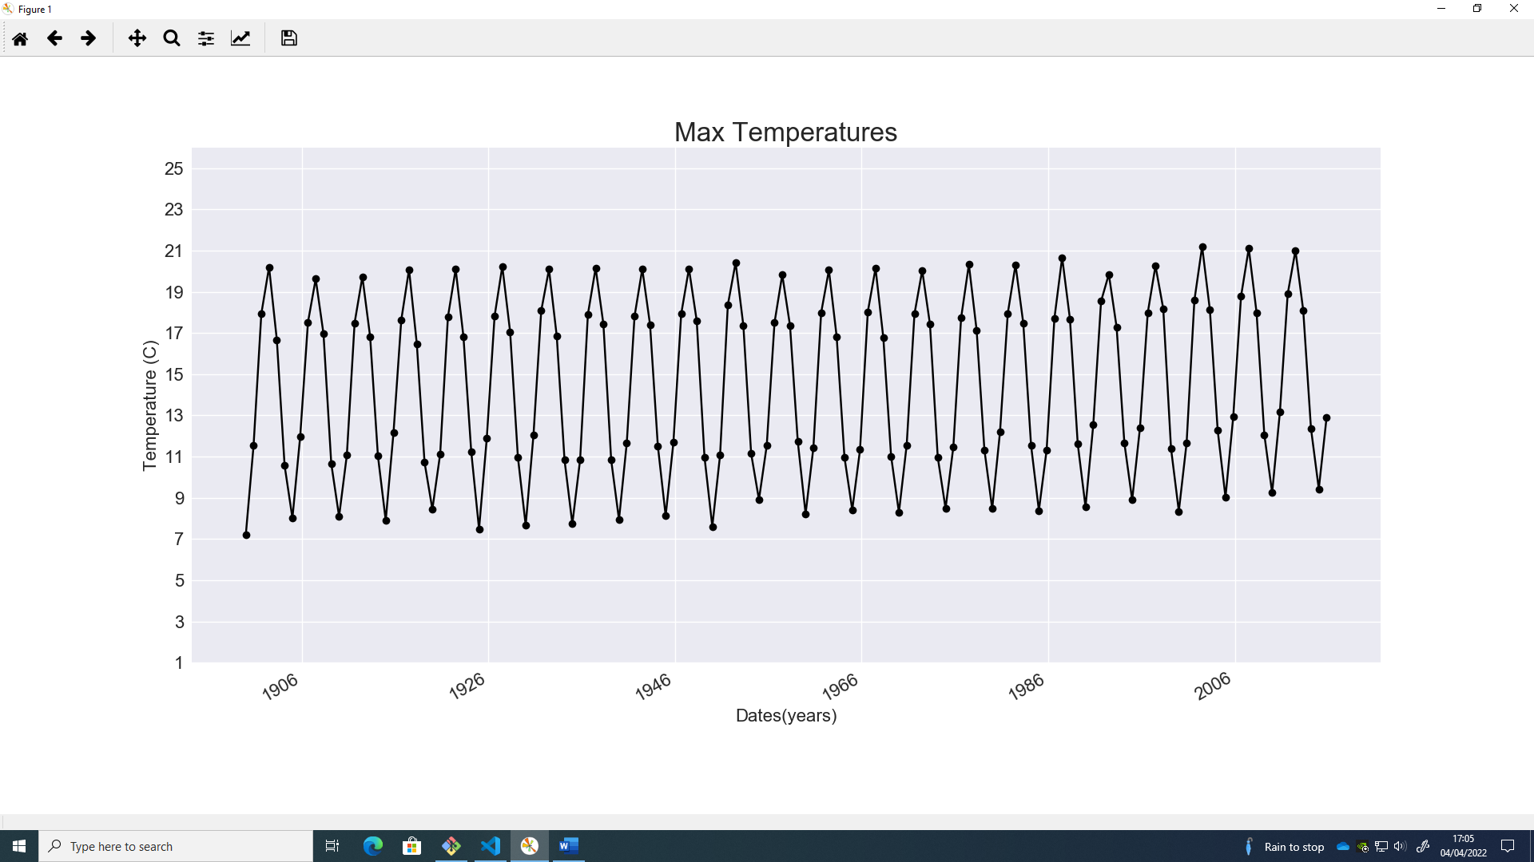
Luke Curran
2/4
This Photo by Unknown Author is licensed under CC BY-NC

Slide 4
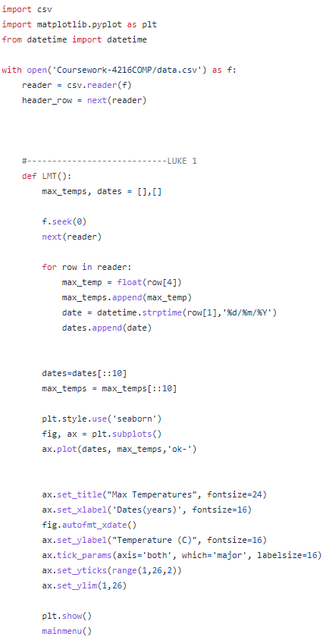
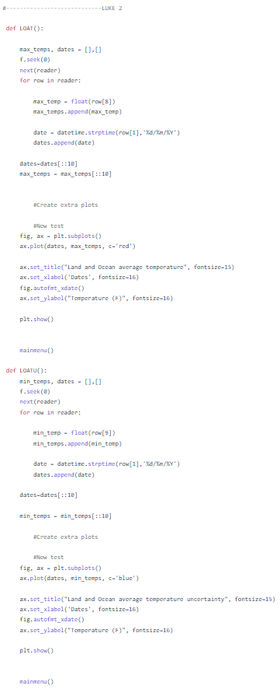
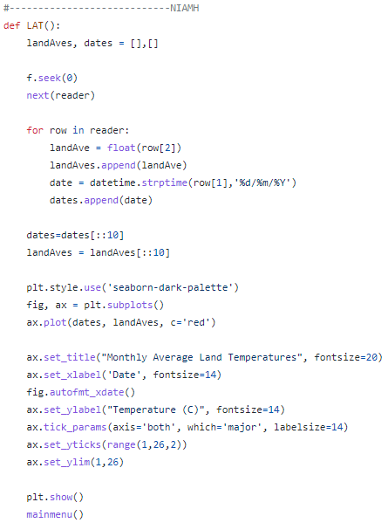
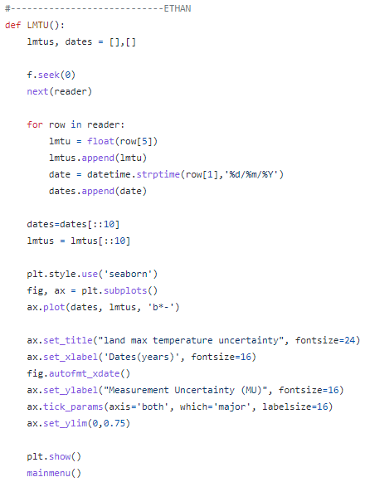


Luke Curran
Code: 1/2
Luke Citrine
3/4
Niamh
Ethan
Luke Curran

Slide 5
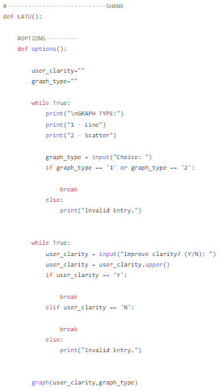
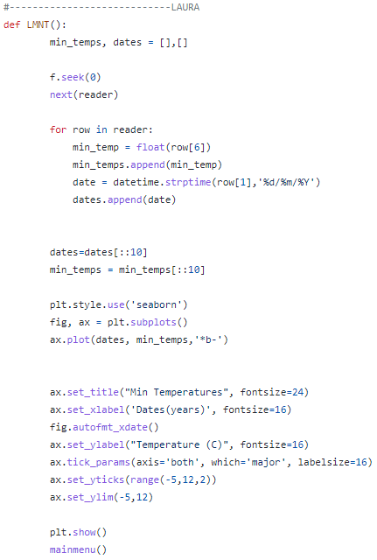
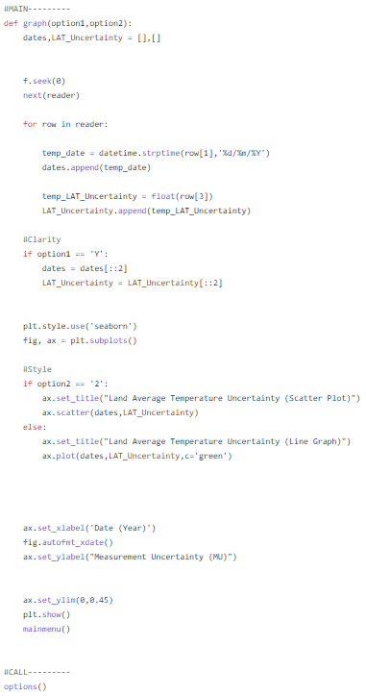

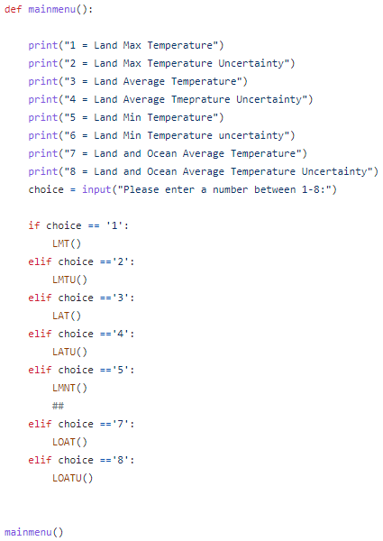


Luke Curran
Shane
Laura
Code: 1/2
4/4
End-User Input
That
went well!

Slide 6
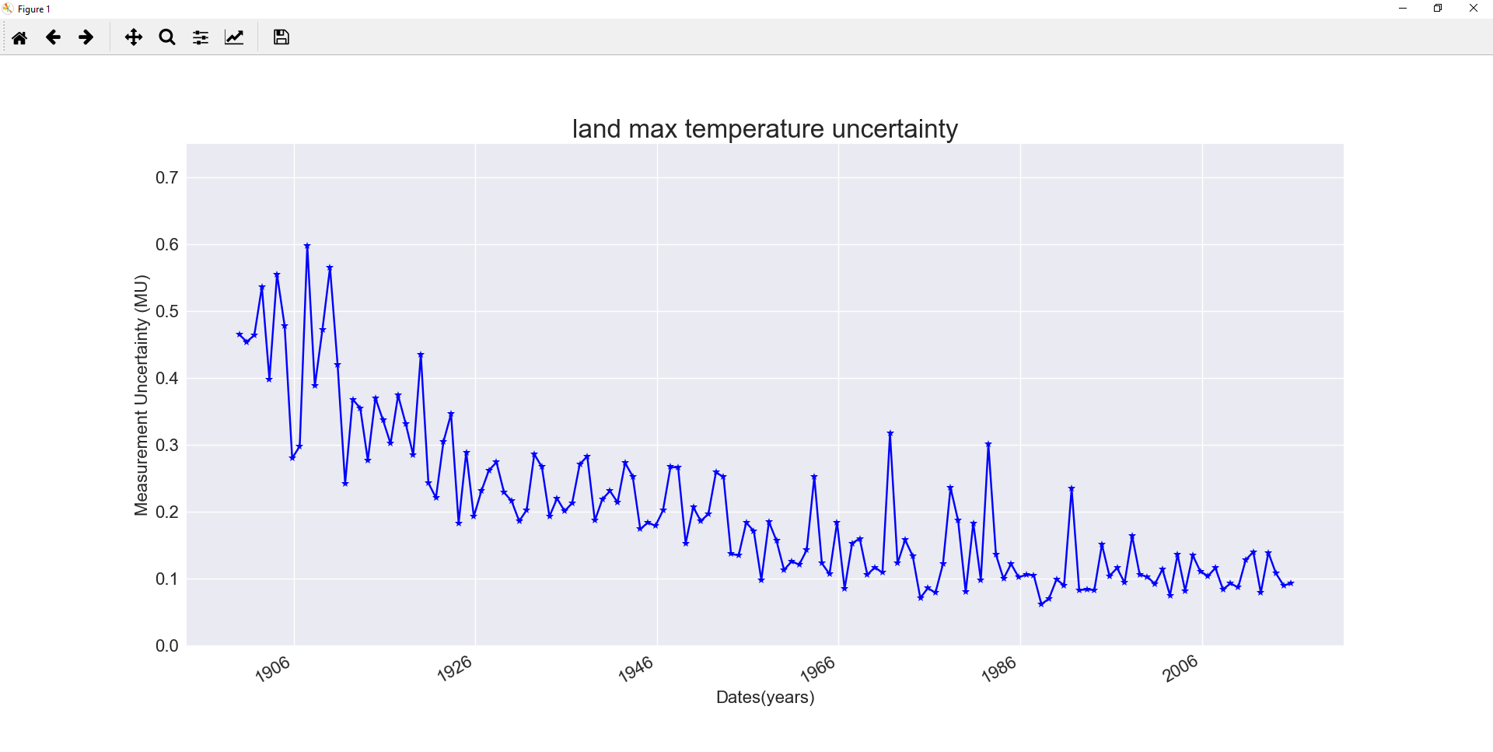


Ethan
Ethan

Slide 7
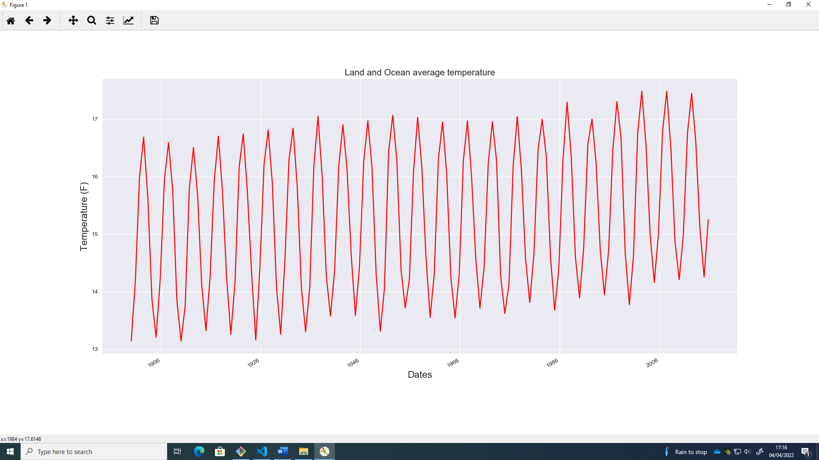
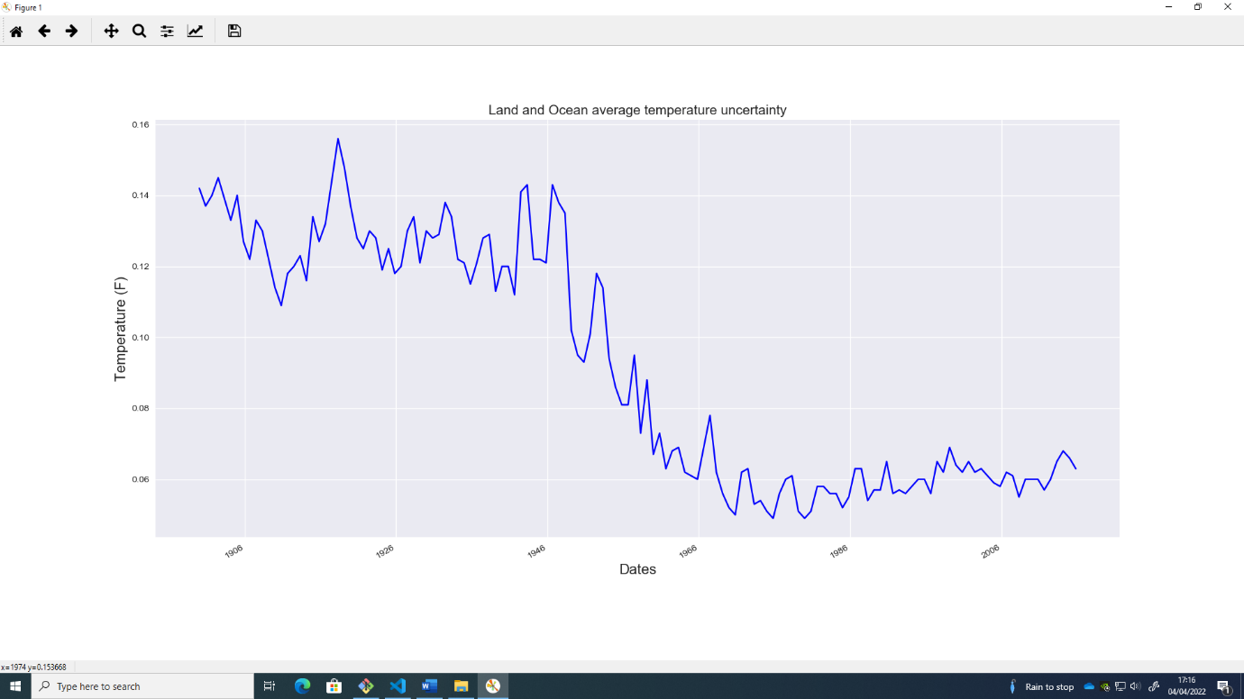

Luke Citrine
Luke Citrine
Learning

Slide 8
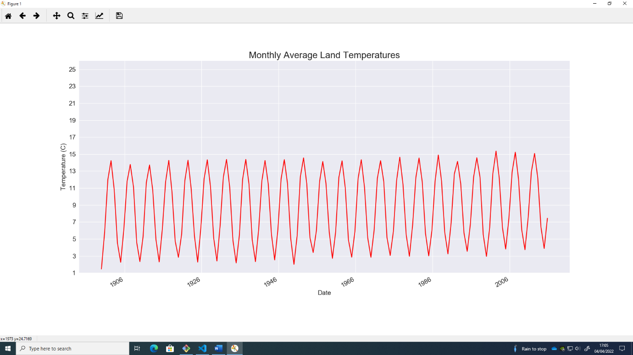

Niamh
Niamh

Slide 9
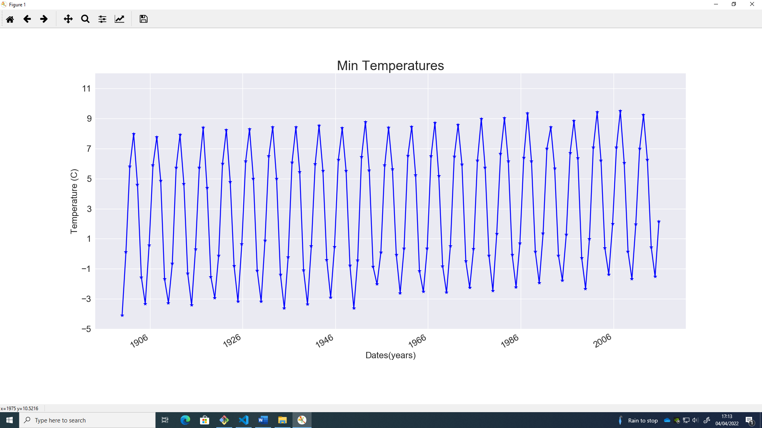

Laura
Laura
Individual and
Team Learning

Slide 10
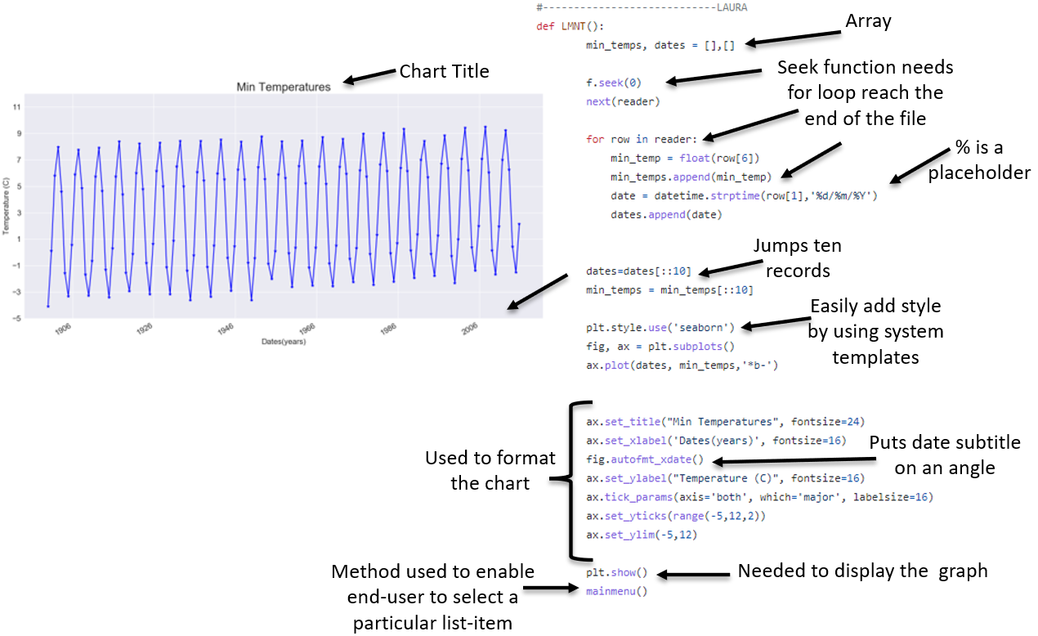
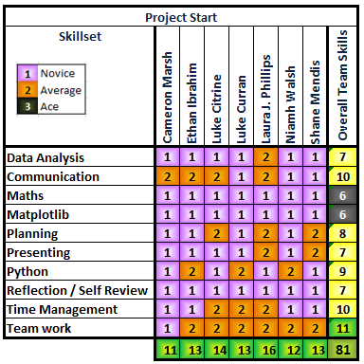
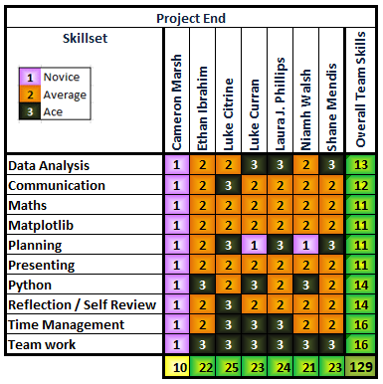
Laura
Individual and
Team Learning

Slide 11
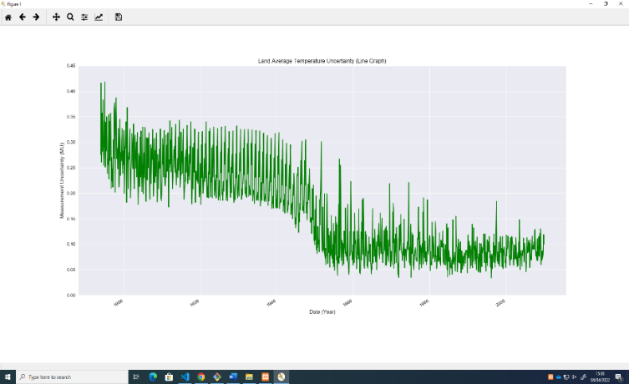

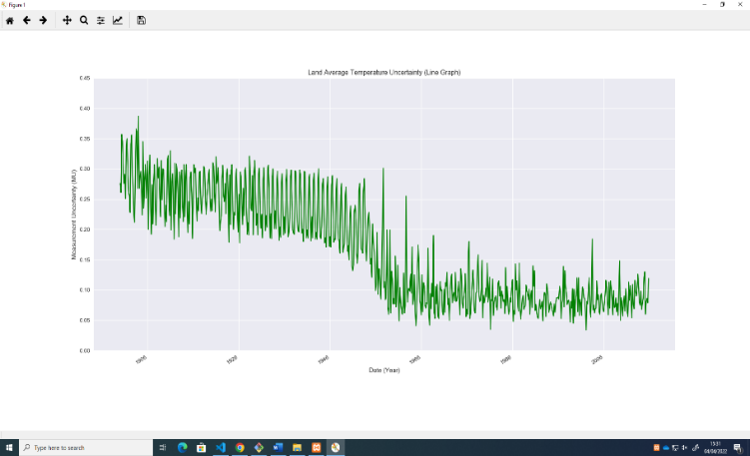
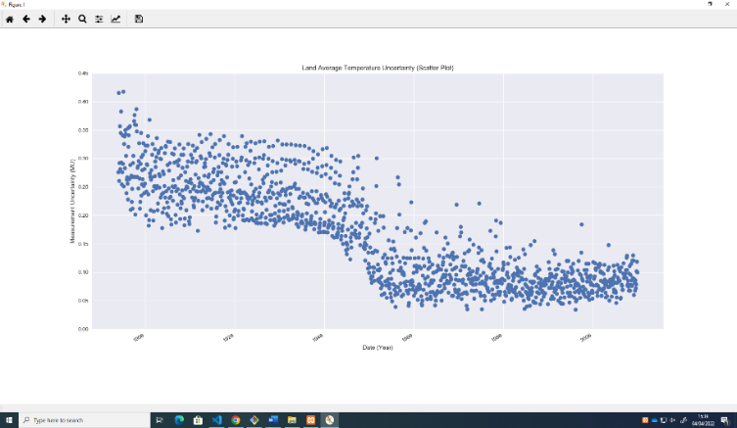

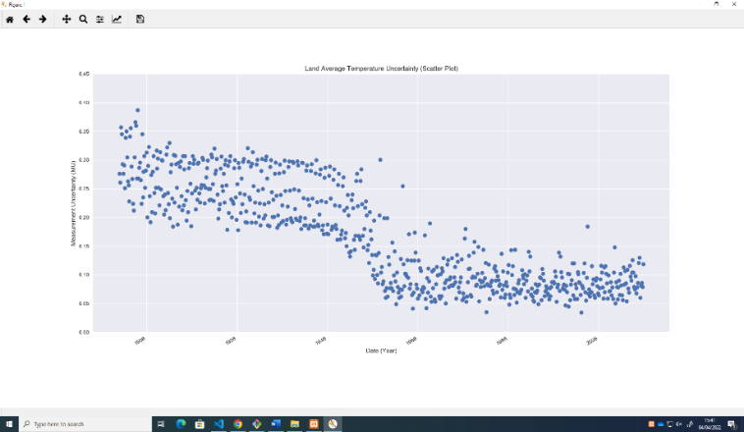
Shane
Shane
Line Graph (Full):
Line Graph (Half):
Scatter Plot (Full):
Scatter Plot (Half):

Slide 12
LUKE 1
Team Work
Line Graph (Full):
Line Graph (Half):
Scatter Plot (Full):
Scatter Plot (Half):

Slide 13
4216 UK Weather Data Analysis
Tuesday 5th April 2022
Thanks for watching this presentation, today.
XXX
Cameron Marsh, Ethan Ibrahim,
Laura J. Phillips, Luke Citrine
Luke Curren, Niamh Walsh, Shane Mendis
Cameron Marsh, Ethan Ibrahim,
Laura J. Phillips, Luke Citrine
Luke Curran, Niamh Walsh, Shane Mendis

